Slide 1
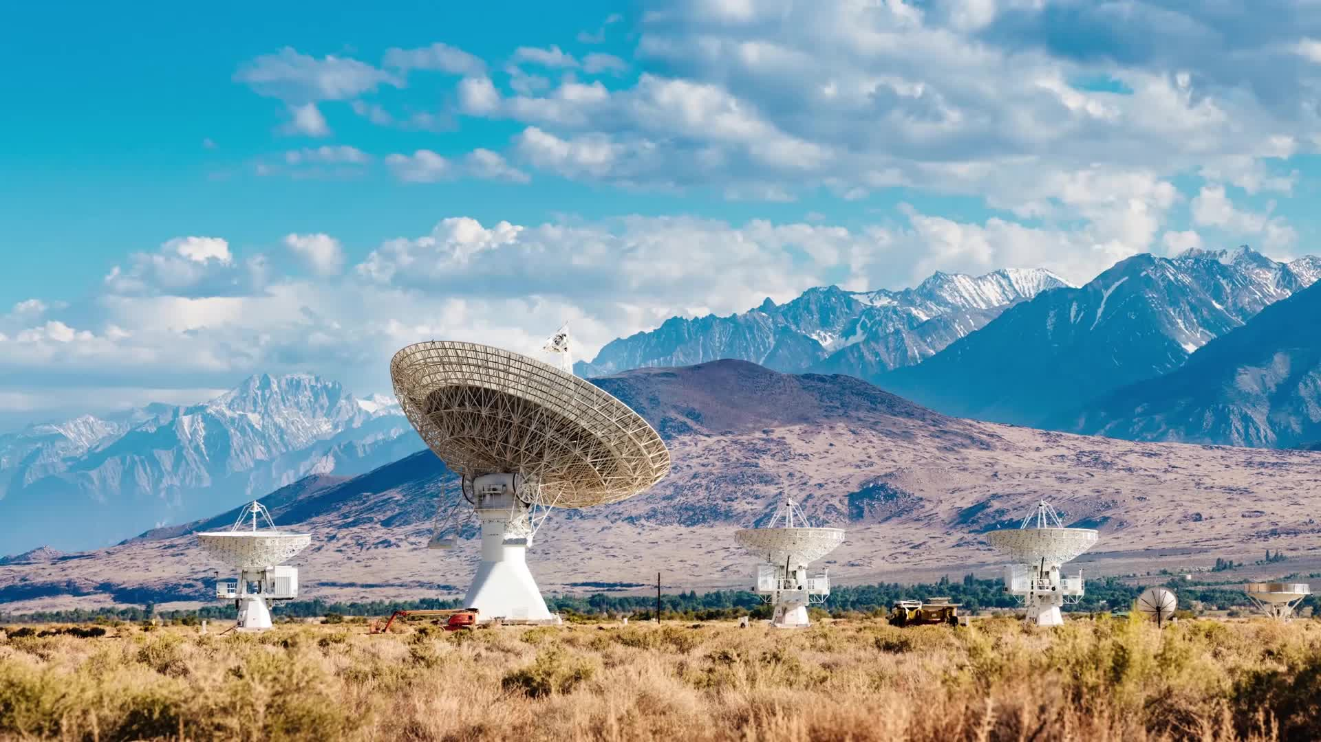
Critical Communications in Remote Areas using LEO Satellites
YICHEN CHEN
n11564628
Major Cyber security
Cluster 6
Tutor Anisur Rahman
Supervisor Muhammad Furqan

Slide 2
Research question
Original
Limited ground infrastructure
High power consumption
(Complex satellite handovers)
Revised
Limited ground infrastructure
Improve residences' life quality in rural area
(Environmental pollution)

Slide 3
Completed experiments and data collection work and data analysis work
Limited ground infrastructure
Starlink UTs are small-sized outdoor dish antennas with a diameter of 58 cm (23 in). In June 2021, SpaceX made an application to FCC to modify the UT size to 48 cm in diameter (approximately 18 in). The UTs operate in the 14.0-14.5 GHz band for uplink and 10.7-12.7 GHz band for downlink, all in the Ku band.
Improve residences' life quality in rural area
Over five years, data was collected on thousands of stroke patients,
documenting their outcomes, such as recovery rates,
mortality, and the time it took to administer critical treatments like intravenous thrombolysis (IVT).
Environmental pollution
There are more than 12,000 trackable pieces of debris over 1a cm in diameter, whereas if we count sizes of 1 cm and up, there are about one million pieces of debris that are present in LEO.

Slide 4
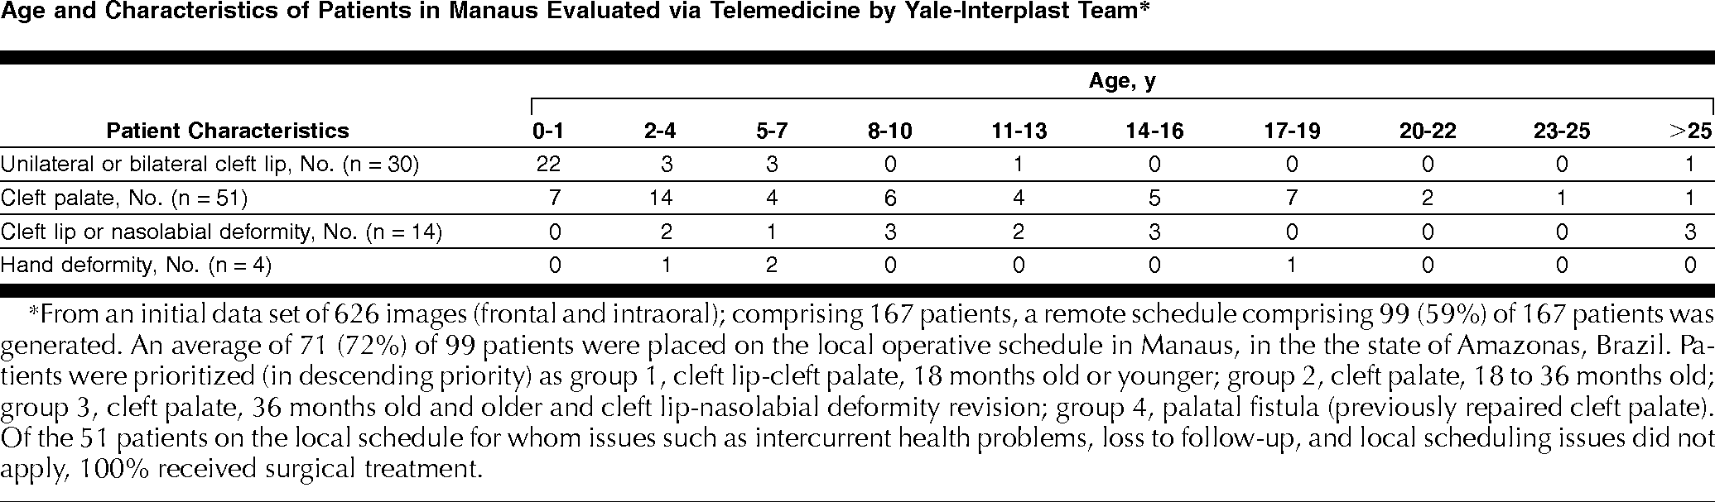
Main results
Telemedicine in rural area -1998
The preoperative diagnoses and specific treatment recommendations made from the remote consultation agreed with evaluations made on-site.

Slide 5
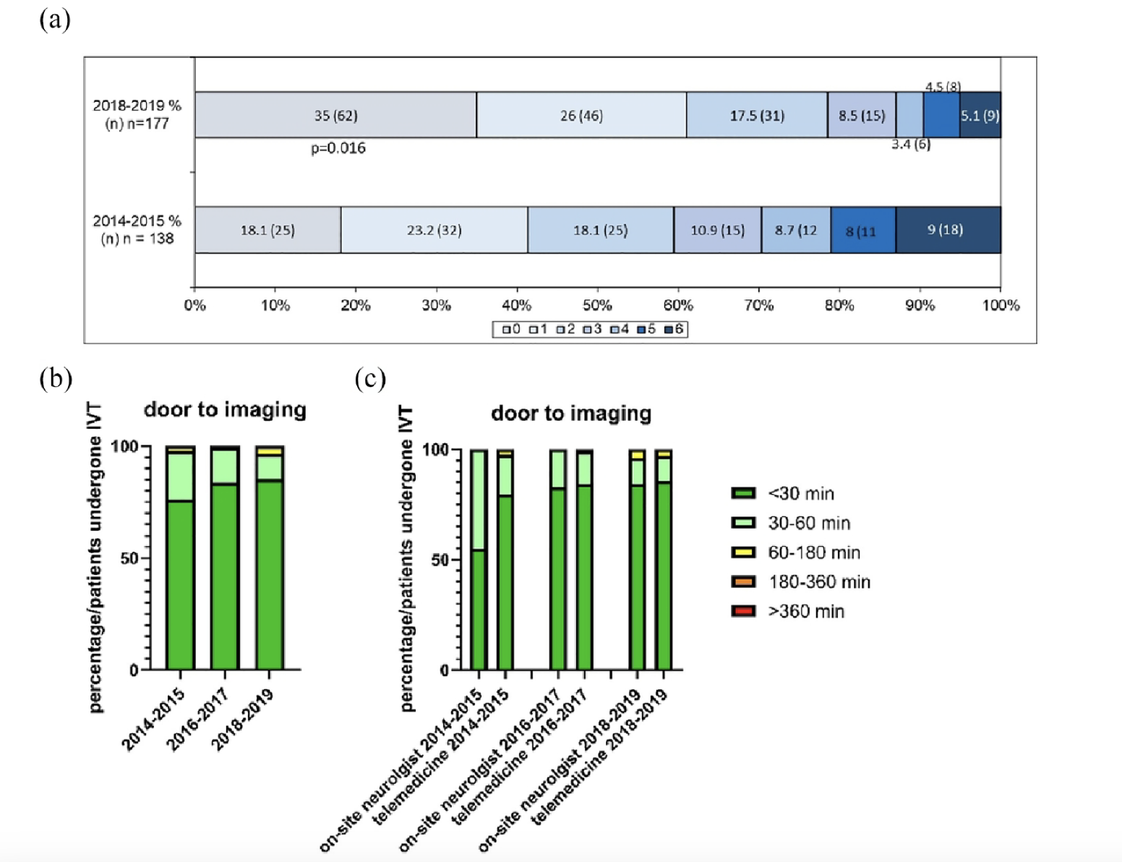
Telemedical in rural area -2024
Notes:
Recently, telemedical stroke networks have offered
instant consultation by stroke experts,
enabling immediate administration of intravenous thrombolysis (IVT) on-site and
decision on thrombectomy.

Slide 6
Main findings and relation to the revised research question
Lower use number of ground stations
Collaboration with local business and government
Improve residences' life quality in rural area
Medecine quality can be improved in rural area
Environmental pollution
Re-regulate relevant rules regularly

Slide 7
Summary remarks and remining work
More possibility in telemedicine technology: Integration of Artificial Intelligence (e.g., AIoT, IoRT)
Implementation of Policy Recommendations: A detailed policy recommendation plan or a framework for satellite management could be developed.

